Slide 1
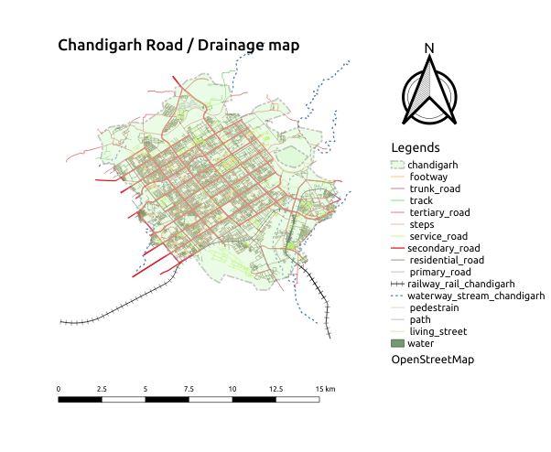
Title: Chandigarh Road Network /Drainage
Map description and analysis
Introduction:
Chandigarh is a union territory which alone
has 56 sectors, beyond which the sector count continues into Mohali, Punjab- a satellite city of Chandigarh. So, sector-57 onwards, all sectors lie in Mohali and not Chandigarh.
Road hierarchy:
The map includes a express way, Drainage , cycling road map / vehicle roadmap for transportation
Chandigarh consist total area of 114 km^2
Road density:
Maval and Mulshi talukas have low road density per area due to restriction of western ghat region and less villages
Bhor and Daund talukas have maximum road density
Rail connectivity:
Chandigarh Junction railway station (station code:- CDG), serves the union territory city of Chandigarh. The station is at an elevation of 330.77 metres (1,085.2 ft) and was assigned the code – CDG. Chandigarh is amongst the top hundred booking stations of Indian Railway.
Air connectivity:
Chandigarh Airport is a custom airport which is the second busiest airport of Indian state of Punjab after Sri Guru Ram Dass Jee International Airport in Amritsar and serves the Union Territory of Chandigarh, and the cities of Mohali and Panchkula in the Indian states of Punjab and Haryana
Team Name: Error402
Topic: Road Network/Drainage Maps.
Team member/
Team lead: Raghav, Pradeep, Pulkit/sourabh singh
Organization: Rural Data Research and Analysis Lab
Data courtesy: BHUVAN, Chandigarh open state map, drainage pipeline map from BHUVAN, Indian district administration boundaries, Maharashtra State Road Development Corporation (MSRDC)
Contact/email: sourabhsingh282@gmail.com

